Slide 1

Analyzing and Predicting Youth Substance Usage: Insights from Decision Tree Analysis
Presented By
LAVANYA BUNADRI

Slide 2
Project analysis slide 2
INTRODUCTION
This study into the dynamics of youth alcohol use through rigorous analysis using decision tree models on data from the National Survey on Drug Use and Health.
It addresses three key objectives: binary classification for alcohol use, multi-class classification for alcohol frequency in the past year, and regression to predict the age of first alcohol use.
By examining demographic variables and youth experiences, the study unveils crucial insights into the factors influencing alcohol consumption among young individuals.
These findings are instrumental in crafting targeted interventions and public health strategies to address and mitigate the challenges posed by alcohol use among the youth population.

Slide 3
Project analysis slide 2
DATASET OVERVIEW
Source: National Survey on Drug Use and Health (NSDUH) – Youth Population (Ages 12–17)
Data Cleaning:
Removed missing values using na.omit()
Converted variables into proper formats (e.g., factor, numeric)
Variable Subsetting:
demographic_cols: Age, Gender , Race,Income, Education, etc.
youth_experience_cols: Peer influence, parental involvement, mental health, substance exposure, school performance.
Target Variables:
whether a youth has ever used alcohol (alcflag): Binary Classification – 0 = Never used alcohol, 1 = Ever used alcohol
alcydays: Multi class classification– Frequency of alcohol use in the past year
iralcage: Regression– Age of first alcohol use
Data Splitting:
70% for training, 30% for testing

Slide 4
Project analysis slide 2
THEORITICAL BACKGROUND
DECISION TREE:
BAGGING:
RANDOM FOREST:
BOOSTING:
METHODOLOGY OVERVIEW:
The methodology began with cleaning the National Survey on Drug Use and Health (NSDUH) dataset using na.omit() to remove missing values.
Subsets of the data were created focusing on demographic features and youth experiences.
The analysis included three core tasks:
Binary classification to predict whether a youth has ever used alcohol (alcflag)
Multi-class classification to predict the frequency of alcohol use in the past year (alcydays)
Regression to estimate the age of first alcohol use (iralcage).
For each task, Decision Trees, Bagging, and Random Forests and Boosting were applied and evaluated using appropriate metrics like accuracy for classification and mean squared error for regression.
Model parameters were tuned, and cross-validation was performed to ensure reliable and generalizable results across all three problem types.

Slide 5
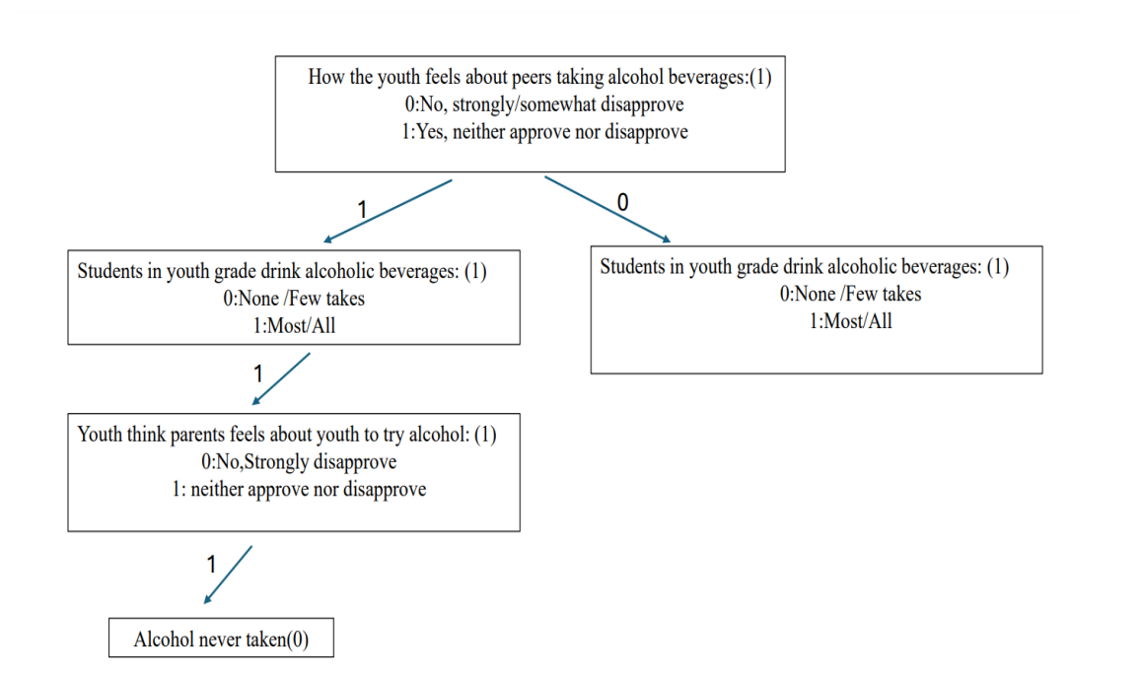
Project analysis slide 2
The tree predicts whether a youth has ever consumed alcohol (Yes = 1, No = 0).
Root Node: Evaluates how the youth feels about peers drinking alcohol:
1 = Neither approve nor disapprove → goes to left branch
0 = Strongly/somewhat disapprove → goes to right branch
Left Branch: Checks if most/all students in their grade drink alcohol:
1 = Yes → moves further
0 = No → ends with prediction
If most/all students drink, the model asks:
How the youth thinks parents feel about them trying alcohol
1 = Neither approve nor disapprove
leads to prediction: Alcohol never taken (0)
Insight:
Even when surrounded by peer alcohol use, lack of strong parental disapproval correlates with non-use.
Highlights the complex interaction between peer influence and parental attitudes.
Binary Classification
Decision Tree Flow

Slide 6
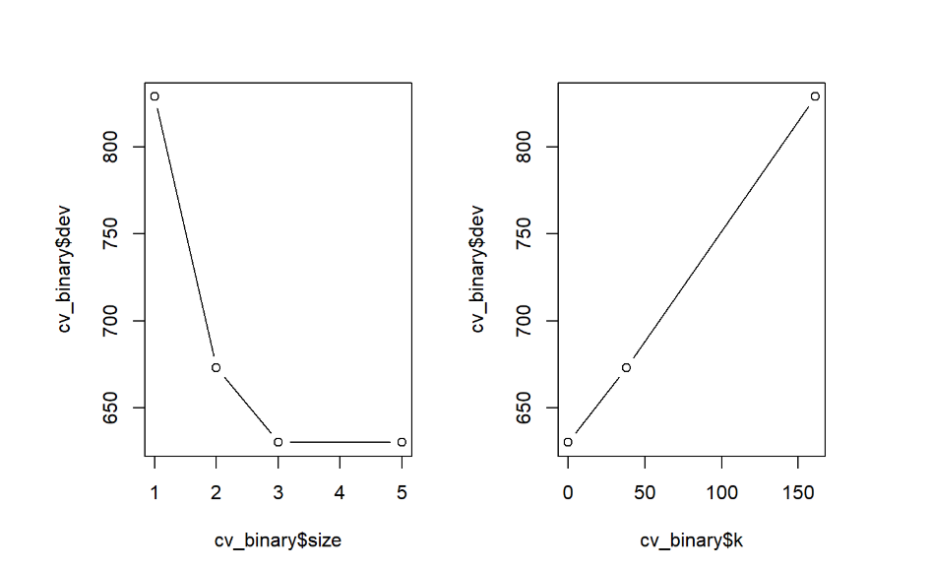
Project analysis slide 2
BINARY CLASSIFICATION
Cross validation of binary classification:
pruning the tree to 3 terminal nodes strikes a balance between simplicity and predictive power.
A low complexity (k) results in a smaller tree with better generalization.
Helps avoid overfitting while maintaining strong classification accuracy.

Slide 7
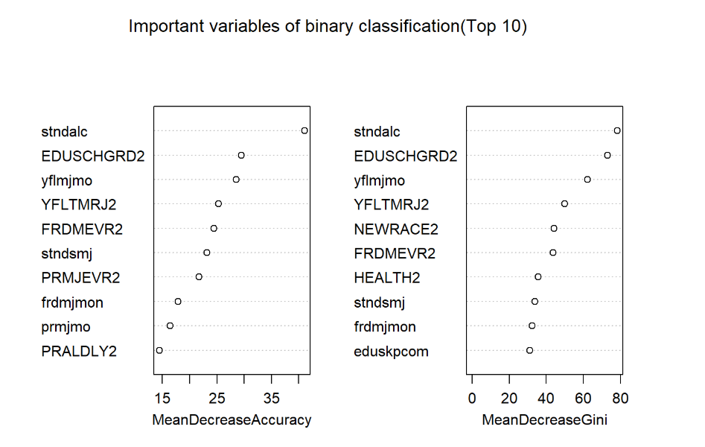
Project analysis slide 2
BINARY CLASSIFICATION
The top 10 variables that strongly predict whether a youth has ever used alcohol are consistent across both accuracy and Gini measures.
Stndalc: students in youth grade drink alcohol beverages.
EDUSCHGRD2-Educational background the youth /student can be in what grade and going to be.
YFLTMRJ2:how youth feels: peers try marijuana drug
Yflmjmo-how the youth feels peers trying marijuana drug monthly.
PRMJEVR2-youth think parents feels about them to trying marijuana drug.

Slide 8
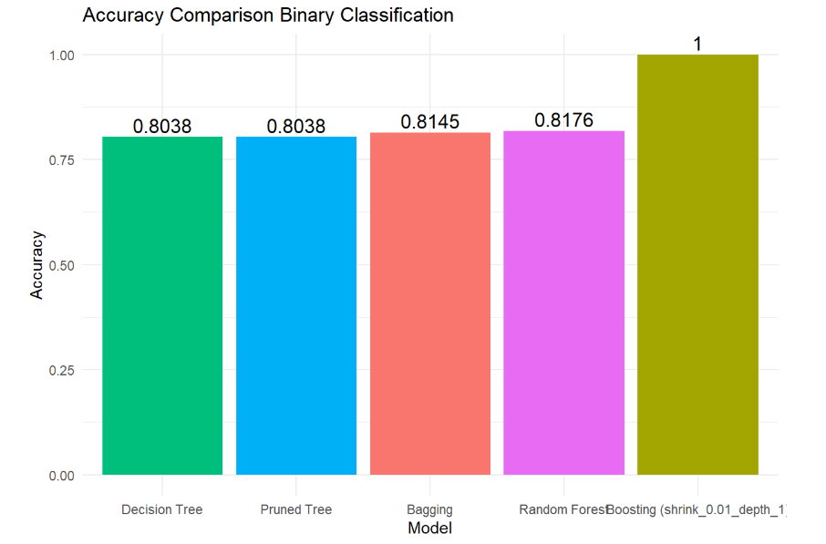
Project analysis slide 2
BINARY CLASSIFICATION
Multiple models were tested to predict whether youth had ever used alcohol.
Decision Tree and Pruned Tree achieved the same accuracy of 80.38%.
Bagging improved performance slightly with 81.45% accuracy.
Random Forest performed better with 81.76% accuracy, indicating the advantage of ensemble methods.
Boosting (with shrinkage = 0.01, depth = 1) achieved 100% accuracy.
Overall, Random Forest and Boosting stand out in performance.

Slide 9
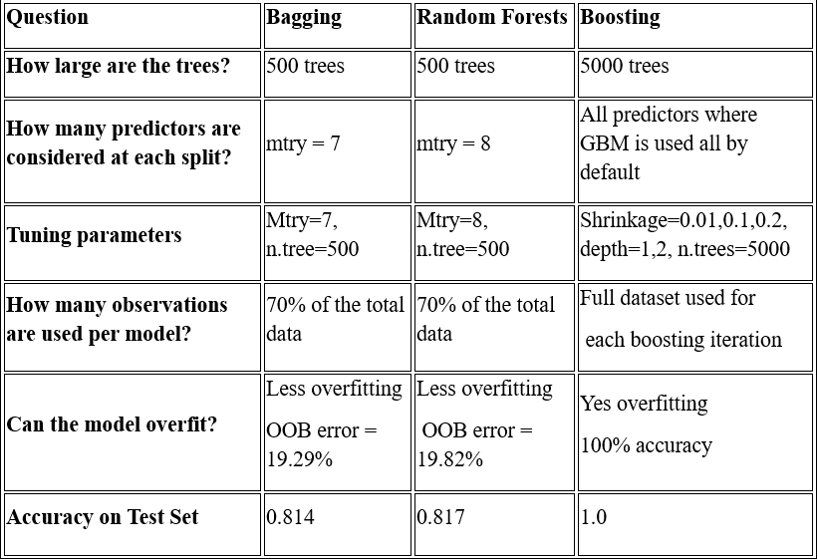
Comparison of Ensemble Methods – Binary Classification

Slide 10
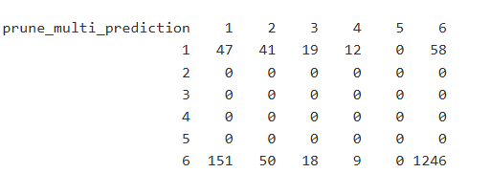
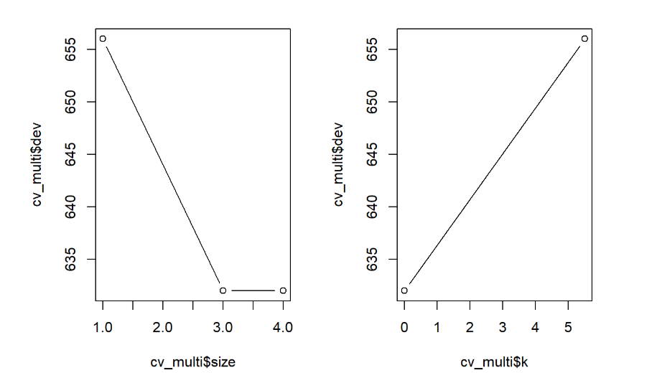
Project analysis slide 2
Multi class Classification
Cross validation of multi class classification
Confusion matrix for the multi-class classification model of pruned decision tree
The rows show the predicted classes from 1 to 6, and columns show the actual classes.
Most accurate predictions fall in class 6 i.e 1246 correctly predicted out of 1306.

Slide 11
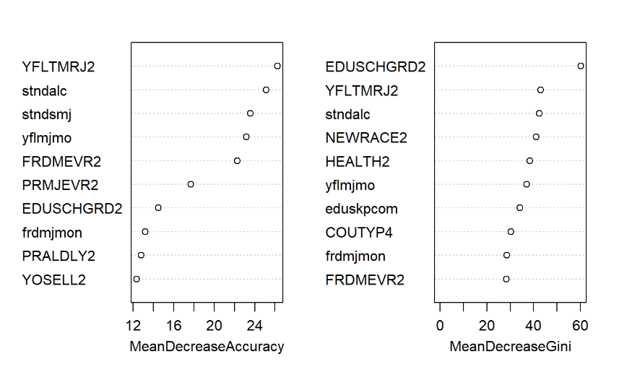
Project analysis slide 2
Multi class Classification
Important variables in multi class classification

Slide 12
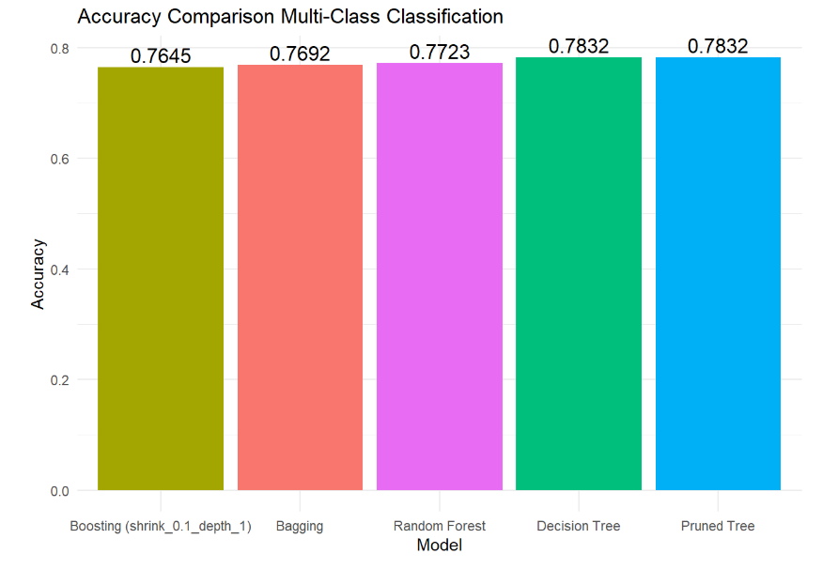
Project analysis slide 2
Multi class Classification

Slide 13
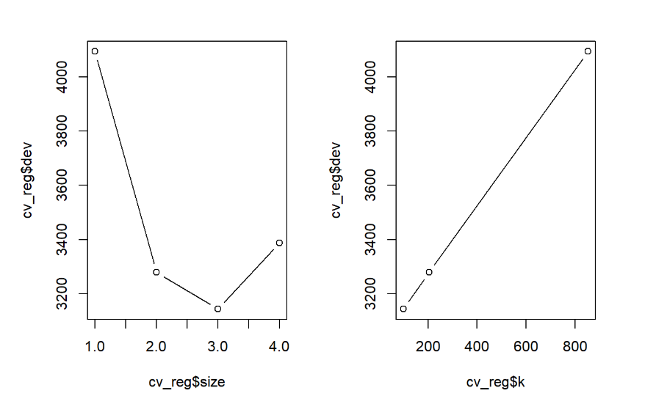
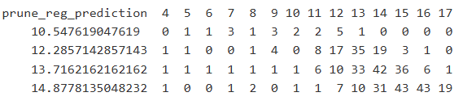
Project analysis slide 2
Regression
Cross validation of regression

Slide 14
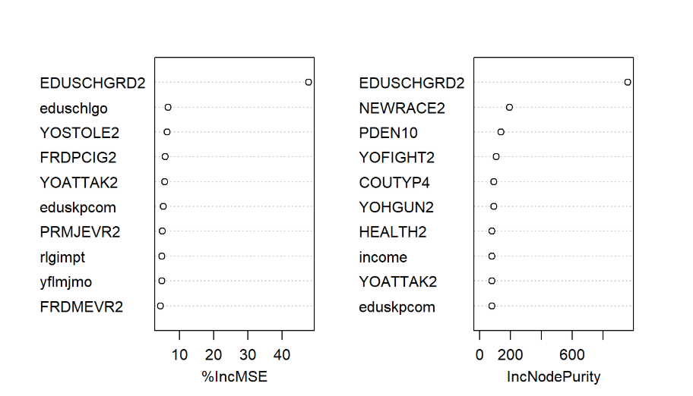
Project analysis slide 2
Regression
Important variables in regression

Slide 15
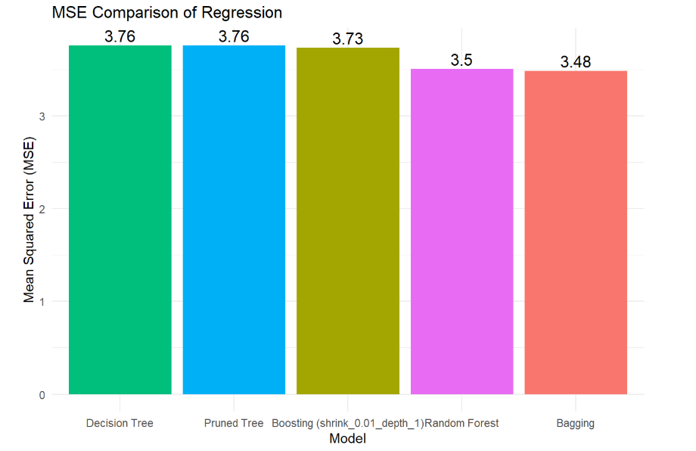

Slide 16
Important Variables for Predicting Alcohol Use
EDUSCHGRD2 (Education Level):
Most consistently important variable across all models -binary, multi-class, regression
Indicates a strong link between academic progression and alcohol use patterns
stndalc (Standard Alcohol Use):
Direct measure of alcohol use behavior
Crucial in both binary and multi-class classification for distinguishing usage levels
YFLTMJR2 (Timing of Marijuana Use):
Strong behavioral predictor
Suggests overlap between alcohol and other substance use patterns
yflmjmo & FRDMEVR2 9Friend/Own Marijuana Use):
Peer influence and personal behavior around marijuana strongly correlate with alcohol use
eduschlgo (School-related goals) & eduskpcom (School performance):
Reflect academic motivation and engagement
Lower educational aspirations and performance related to higher alcohol risk

Slide 17
Conclusion
Across the ensemble methods, boosting is the most consistent top performer, offering superior accuracy in both classification and regression tasks when properly tuned.
In terms of variable importance, key predictors of youth alcohol use included factors such as grade levels, peer influence variables and family structure, income, and youth risk behaviors. These variables were consistently identified as influential across binary, multi-class, and regression models.
By changing variables like alcflag ,alcydays and iralcage into binary, ordinal, or number formats, we can look at alcohol use in different ways in binary it helps answer yes or no questions, ordinal shows how often alcohol is used, and numbers help find patterns like the age when drinking started. This makes it easier to pick the right model based on what we want to predict.
Binary classification using the random forest achieved the highest overall accuracy of 0.8176, making it the most effective method for predicting the frequency of alcohol use among youth.
These findings are really useful for people like health workers, teachers, and policymakers. By spotting the risks and patterns in alcohol use, they can create better, targeted plans to help young people stay healthier and safer.

Slide 18
Thank You

